Slide 1



South Westphalia University of Applied Sciences
Data Science Project Seminar Driving Corporate Performance
Summer Semester 2025
Management Data Summary
Md Abdullah Al Noman Mridha (Matriculation number: 30494592)

Slide 2
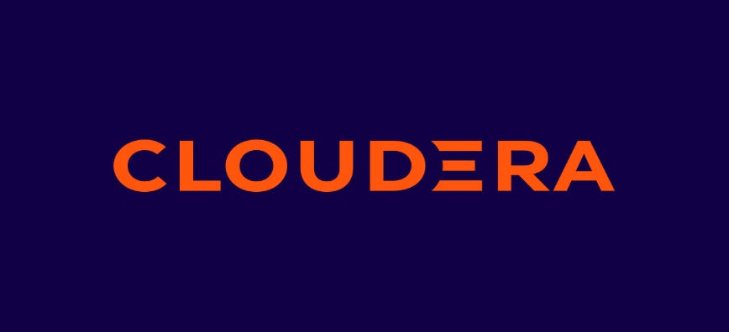

Cloudera Overview
Cloudera is a leading data company that provides a hybrid data platform designed for data engineering, data warehousing, machine learning, and analytics. Founded in 2008, Cloudera pioneered the development of open-source big data platforms based on Apache Hadoop
Cloudera, Inc. (2023). About us. https://www.cloudera.com/about.html

Slide 3

Cloudera: Enterprise Data Management
Unified Hybrid/Multi-Cloud Platform
Hadoop-Based Solution
Centralized Data Management
Data Lifecycle Components
Cloudera offers a unified platform for large-scale data engineering, analytics, ML & Governance
Specializes in Hadoop-based solutions tailored for complex data workflows.
Cloudera Data Platform (CDP) centralizes the entire data lifecycle management
CDP manages data ingest, processing, analysis and governance seamlessly.
Cloudera, Inc. (2023). Cloudera Data Platform: The enterprise data cloud. https://www.cloudera.com/products/cloudera-data-platform.html

Slide 4
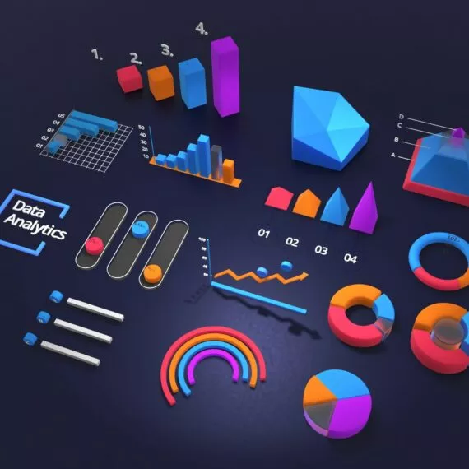




Cloudera's Data Management Features
Data Governance with SDX
SDX enforces consistent security, metadata and compliance policies for data governance.
Scalability Across Clouds
Cloudera supports petabytes of data across hybrid clouds including AWS, Azure and on-prem solutions.
Analytics and Machine Learning Tools
Tools like Cloudera Machine Learning (CML) enable self-service analytics and insights.
Robust Security Features
Cloudera offers role-based access control (RBAC), encryption and audit trails for security.
Cloudera, Inc. (2023). Cloudera data management platform. https://www.cloudera.com/products/cloudera-data-platform.html

Slide 5
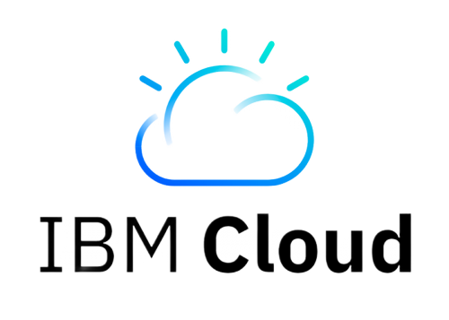
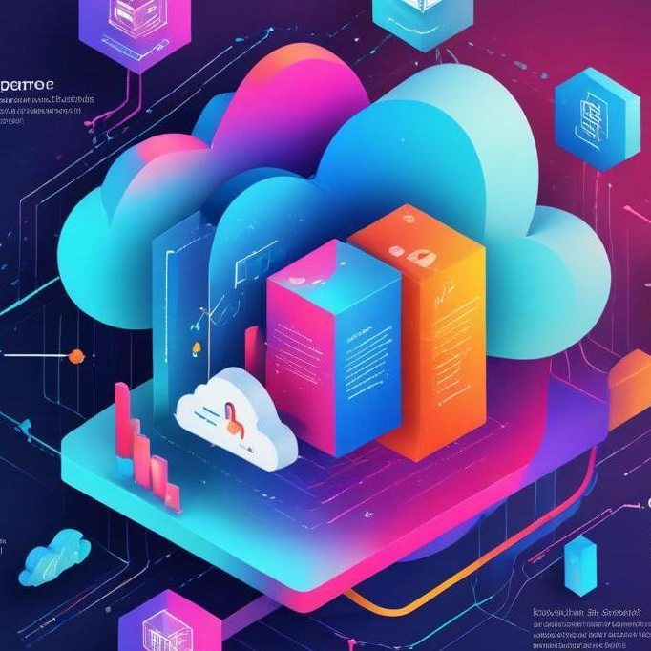
IBM Cloud Overview
IBM Cloud is a comprehensive cloud computing platform developed by IBM that offers both infrastructure-as-a-service (IaaS) and platform-as-a-service (PaaS) capabilities. It supports a wide range of services including compute, storage, artificial intelligence, analytics, DevOps, and security.
IBM. (2023). What is IBM Cloud? https://www.ibm.com/cloud/what-is-cloud-computing

Slide 6



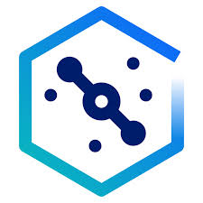

IBM Cloud: AI-Driven Data Management
Full-stack Cloud Platform
Offers a comprehensive cloud solution with AI/ML capabilities, enhancing data workflows.
AI/ML Integration
Utilizes IBM Watson for intelligent automation and data analysis, improving decision-making.
Hybrid Cloud Leadership
Leverages Red Hat OpenShift for seamless integration across multiple cloud environments.
IBM Cloud Pak for Data
A unified platform facilitating data integration, governance and AI automation for enterprises.
Target Users
Designed for enterprises seeking AI-driven insights and flexibility in hybrid/multi-cloud setups.
IBM. (2023). IBM Cloud: Accelerate innovation with hybrid cloud and AI. https://www.ibm.com/cloud
IBM. (2023). IBM Cloud Pak for Data. https://www.ibm.com/products/cloud-pak-for-data

Slide 7
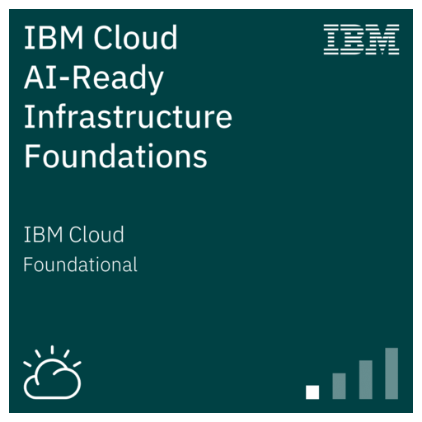
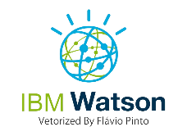
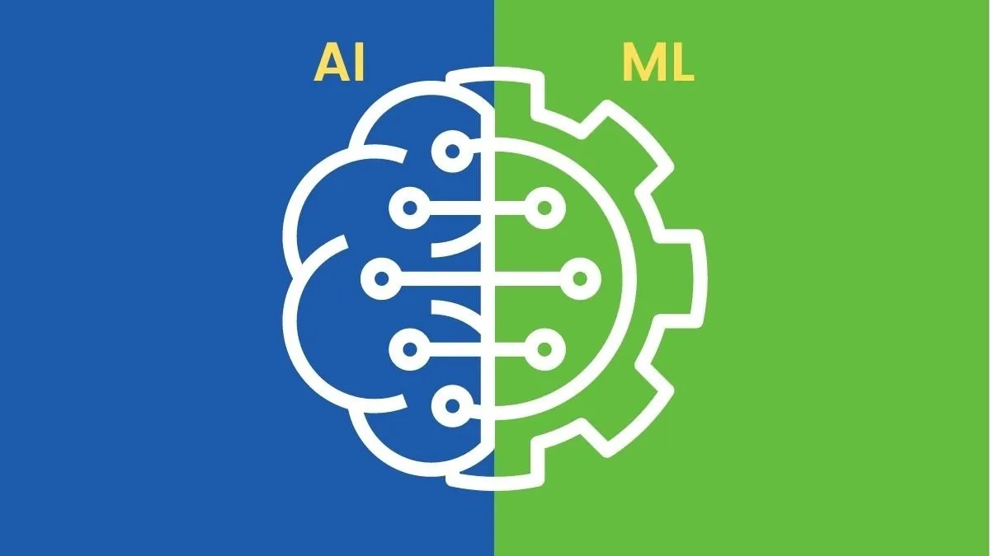
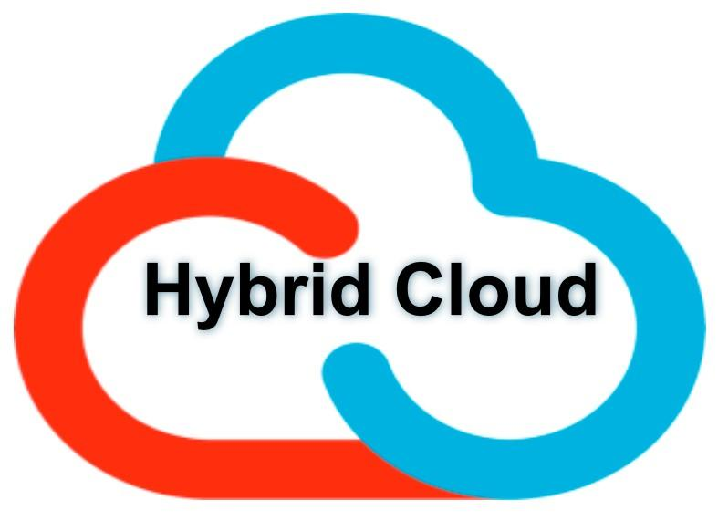

IBM Cloud – Key Features for Data Management
Data Integration with Watson Query
Enables federated queries across distributed data sources, enhancing data accessibility.
AI and ML Integration
Utilizes Auto AI for automated model building and Watson Studio for collaborative machine learning.
Hybrid Cloud Capabilities
Facilitates seamless data portability across public, private and on-premise environments.
Robust Security Features
Offers ‘Keep Your Own Key’ encryption and ensures GDPR Compliance for data protection.
IBM. (2023). IBM Cloud Pak for Data: Unify and simplify your data. https://www.ibm.com/products/cloud-pak-for-data

Slide 8
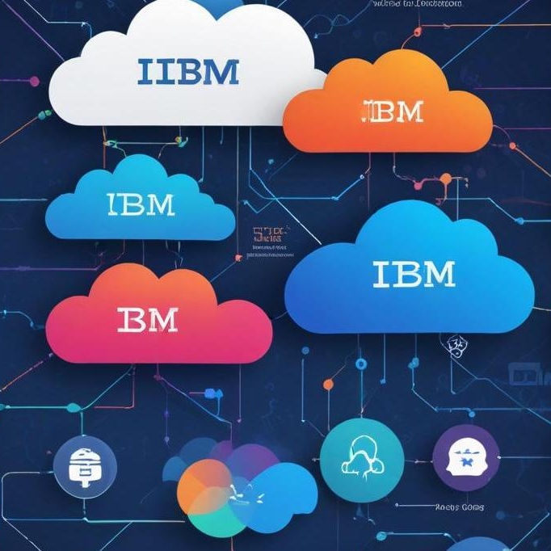
Thank you!
Do you have any questions?

